Slide 1
Indexing and Hashing
-Ashu Mehta
Database systems

Slide 2
Indexing
Indexing is a data structure technique to efficiently retrieve records from database files based on some attributes on which the indexing has been done.
Indexing in database systems is similar to the one we see in books.
Two basic kinds of indices:
Ordered indices: search keys are stored in sorted order
Hash indices: used to access data that is distributed uniformly across a range of buckets using a “hash function”.

Slide 3
Purpose of Indexing
It is a data structure that is added to a file to provide faster access to the data.
It reduces the number of blocks that the DBMS has to check.

Slide 4
Index Evaluation Metrics
Access types: Access types supported efficiently. E.g.,
records with a specified value in the attribute
or records with an attribute value falling in a specified range of values.
Access time: Time it takes to find a particular data item, or set of items, using the technique
Insertion time: Time it takes to insert a new data item. This value includes the time it takes to find the correct place to insert the new data item, as well as the time it takes to update the index structure
Deletion time: Time it takes to delete a data item. This value includes the time it takes to find the item to be deleted, as well as the time it takes to update the index structure
Space overhead: The additional space occupied by an index structure.

Slide 5
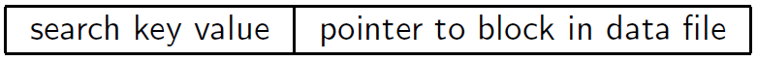
Basic Concepts
Search Key: An attribute or set of attributes used to look up records in a file is called search key.
An Index file consists of records( called index entries) of the form

Slide 6
Ordered Indices
Each index structure is associated with a particular search key.
An ordered index, stores the value of the search keys in sorted order and associates with each search key the record that contains it. E.g., index of a book, library catalog.
A file may have several indices, on different search keys.

Slide 7
Ordered Indices
Primary index: in a sequentially ordered file, the index whose search key specifies the sequential order of the file.
Also called clustering index
The search key of a primary index is usually but not necessarily the primary key.
Secondary index: an index whose search key specifies an order different from the sequential order of the file.
Also called non-clustering index.
Index-sequential file: ordered sequential file with a primary index.

Slide 8
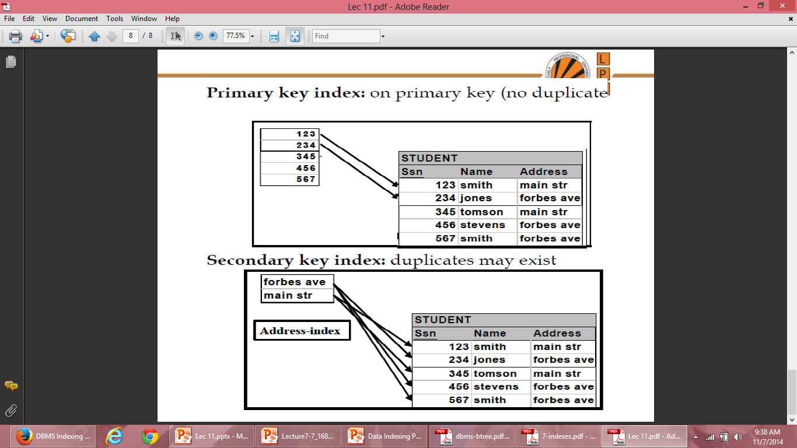

Slide 9
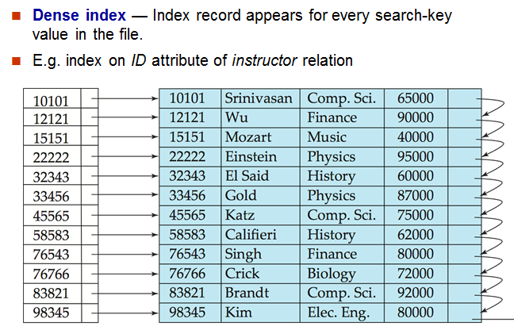
Dense Index Files

Slide 10
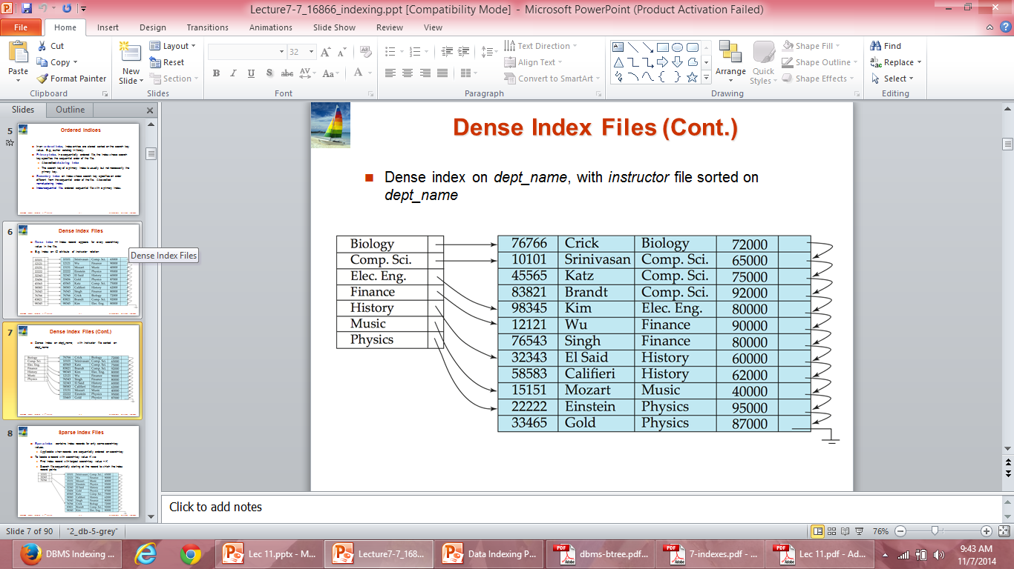
Dense Index Files

Slide 11
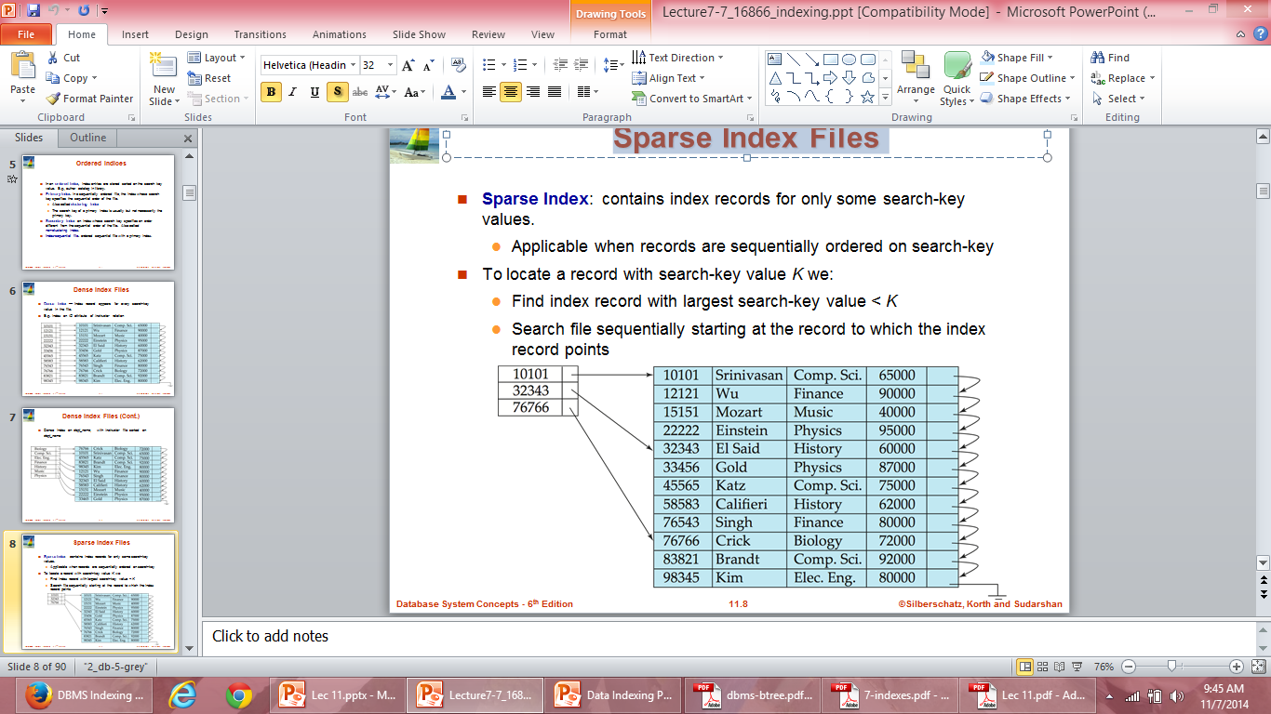
Sparse Index Files

Slide 12
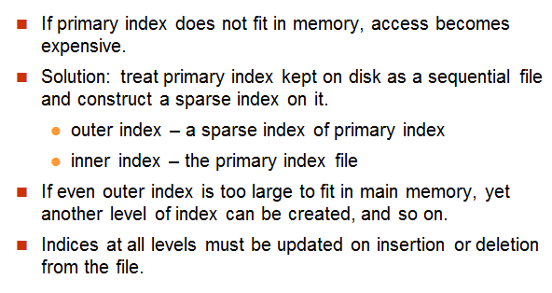
Multilevel Index

Slide 13
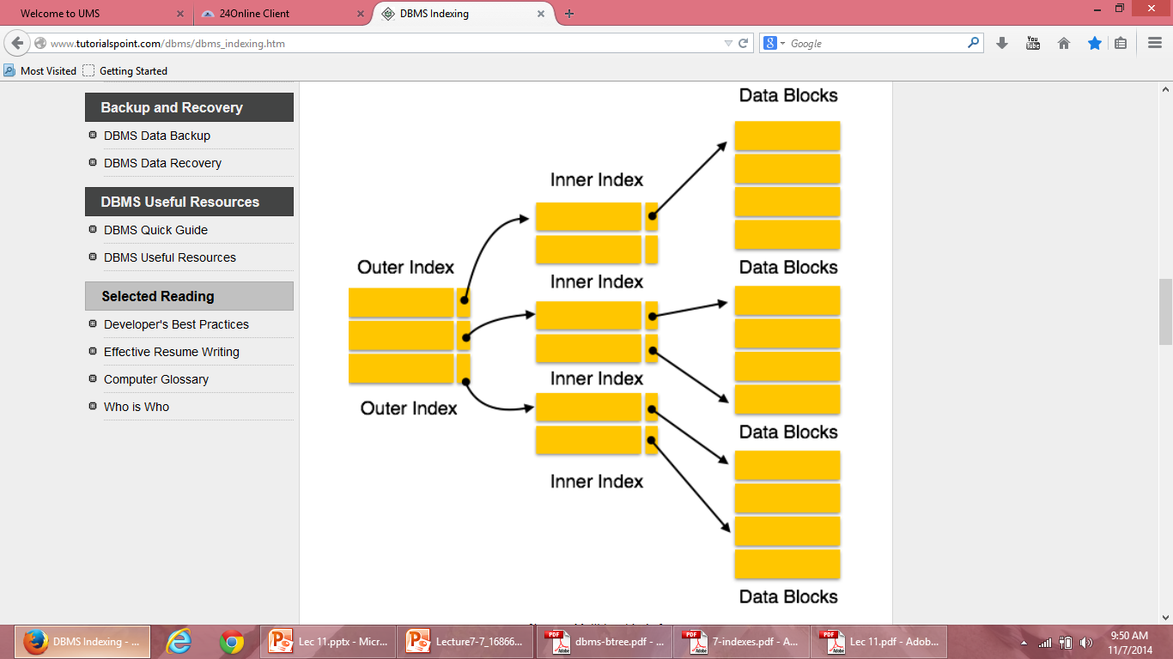
Multilevel Index

Slide 14
Secondary Indices
Secondary indices must be dense, with an index entry for every search-key value, and a pointer to every record in the file.
A primary index may be sparse, storing only some of the search-key values, since it is always possible to find records with intermediate search-key values by a sequential access to a part of the file.

Slide 15
Secondary Indices
If the search key of a secondary index is not a candidate key, it is not enough to point to just the first record with each search-key value. The remaining records with the same search-key value could be anywhere in the file, since the records are ordered by the search key of the primary index, rather than by the search key of the secondary index.
Therefore, a secondary index must contain pointers to all the records.
An extra level of indirection is used to implement secondary indices on search keys that are not candidate keys.

Slide 16
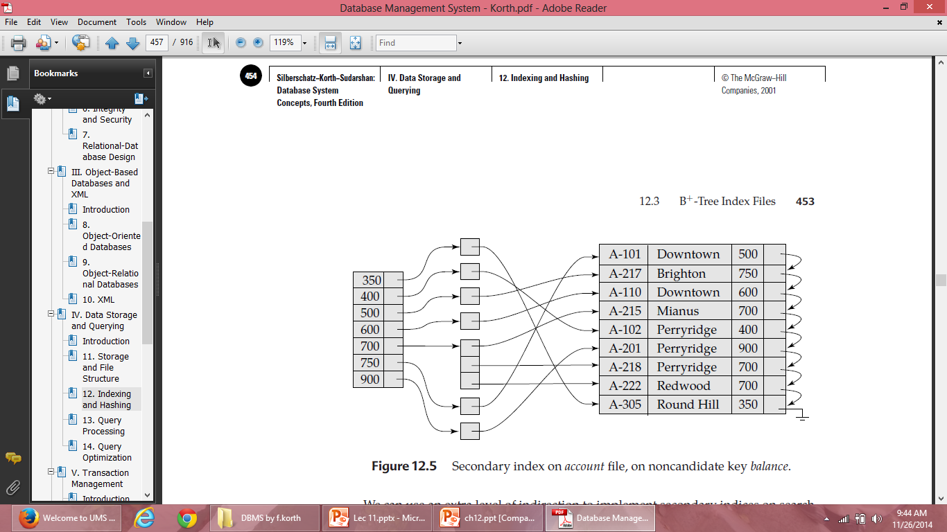
EXAMPLE

Slide 17
Hashing
One disadvantage of sequential file organization is that we must access an index structure to locate data, or must use binary search, and that results in more I/O operations.
File organizations based on the technique of hashing allow us to avoid accessing an index structure.
Hashing also provides a way of constructing indices.

Slide 18
Example
Hash file organization of account file, using branch_name as key
There are 10 buckets,
The binary representation of the ith character is assumed to be the integer i.
The hash function returns the sum of the binary representations of the characters modulo 10
E.g. h(Perryridge) = 5 h(Round Hill) = 3 h(Brighton) = 3

Slide 19
Hashing
A bucket is a unit of storage containing one or more records (a bucket is typically a disk block).
In a hash file organization we obtain the bucket of a record directly from its search-key value using a hash function.
Hash function h is a function from the set of all search-key values K to the set of all bucket addresses B.
Hash function is used to locate records for access, insertion as well as deletion.
Records with different search-key values may be mapped to the same bucket; thus entire bucket has to be searched sequentially to locate a record.

Slide 20
Static Hashing
In static hashing, when a search-key value is provided the hash function always computes the same address.
For example, if mod-4 hash function is used then it shall generate only 5 values. The output address shall always be same for that function. The numbers of buckets provided remain same at all times.

Slide 21
Hash Function
Worst hash function maps all search-key values to the same bucket; this makes access time proportional to the number of search-key values in the file.
An ideal hash function is having following properties:
The distribution is uniform. That is, the hash function assigns each bucket the same number of search-key values from the set of all possible search-key values.
The distribution is random. That is, in the average case, each bucket will have nearly the same number of values assigned to it, regardless of the actual distribution of search-key values.

Slide 22
Handling of Bucket Overflows
If the bucket does not have enough space, a bucket overflow is said to occur.
Bucket overflow can occur for several reasons:
Insufficient buckets: The number of buckets, denoted by nB , must be chosen such that nB > nr /fr, where nr denotes the total number of records that will be stored and fr denotes the number of records that will fit in a bucket.
Skew: Some buckets are assigned more records than are others, so a bucket may overflow even when other buckets still have space. This situation is called bucket skew. This can occur due to two reasons:
multiple records have same search-key value
chosen hash function produces non-uniform distribution of key values

Slide 23
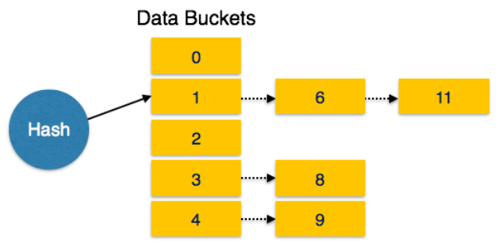
Handling of Bucket Overflows
Although the probability of bucket overflow can be reduced, it cannot be eliminated; it is handled by using overflow buckets.
Overflow chaining – the overflow buckets of a given bucket are chained together in a linked list.
Above scheme is called closed hashing.

Slide 24
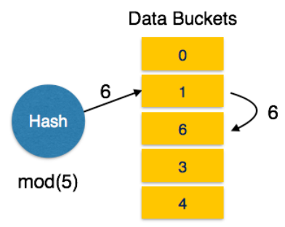
Handling of Bucket Overflows
Linear Probing: When hash function generates an address at which data is already stored, the next free bucket is allocated to it. This mechanism is called Open Hashing.
Open hashing does not use overflow buckets, is not suitable for database applications.

Slide 25
Hash Indices
Hashing can be used not only for file organization, but also for index-structure creation.
A hash index organizes the search keys, with their associated record pointers, into a hash file structure.
The hash function is constructed as follows:
Apply hash function on a search key to identify a bucket, and store the key and its associated pointers in the bucket
Strictly speaking, hash indices are always secondary indices
if the file itself is organized using hashing, a separate primary hash index on it using the same search-key is unnecessary.
However, we use the term hash index to refer to both secondary index structures and hash organized files.

Slide 26
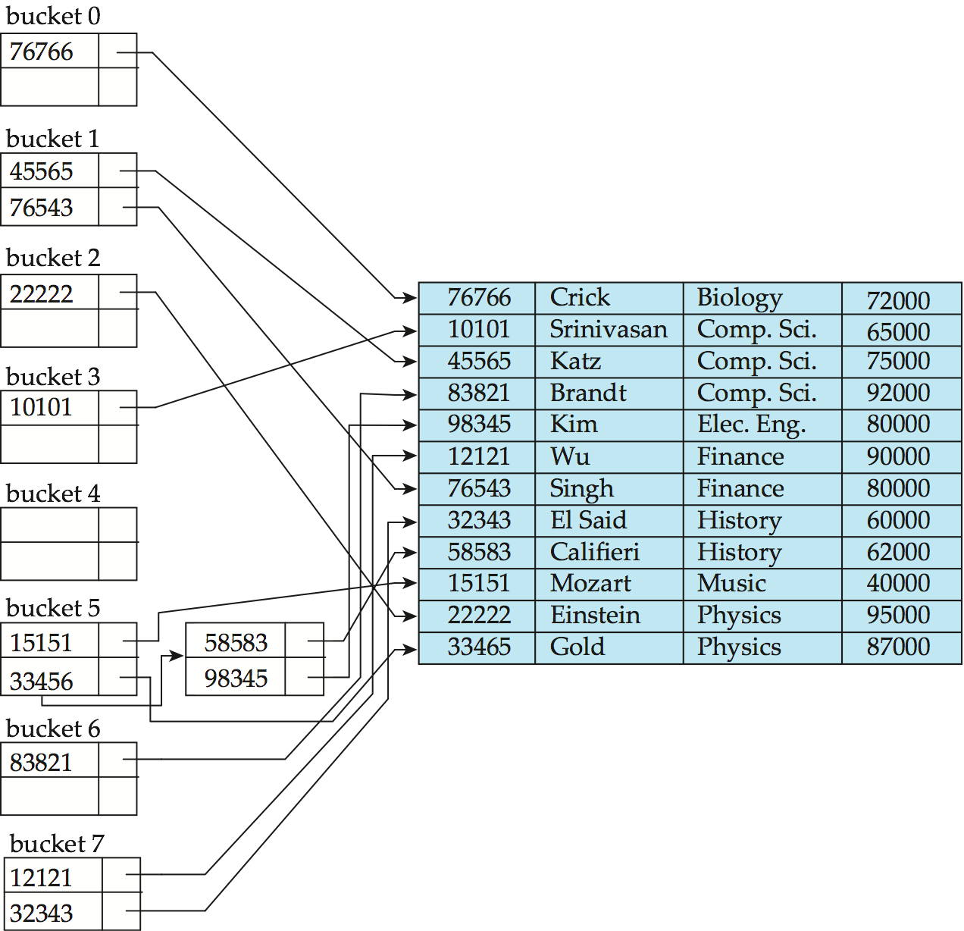
Example of Hash Index

Slide 27
Deficiencies of Static Hashing
In static hashing, function h maps search-key values to a fixed set of B of bucket addresses. Databases grow or shrink with time.
If initial number of buckets is too small, and file grows, and the hash function is choose based on the current file size, performance will degrade due to too much overflows.
If space is allocated for anticipated growth, a significant amount of space will be wasted initially (and buckets will be underfull).
If database shrinks, again space will be wasted.
One solution: periodic re-organization of the file with a new hash function
Expensive, disrupts normal operations
Better solution: allow the number of buckets to be modified dynamically.

Slide 28
Dynamic Hashing
Dynamic hashing provides a mechanism in which data buckets are added and removed dynamically and on-demand.
Dynamic hashing is also known as extended hashing.
Hash function, in dynamic hashing, is made to produce large number of values and only a few are used initially.

Slide 29
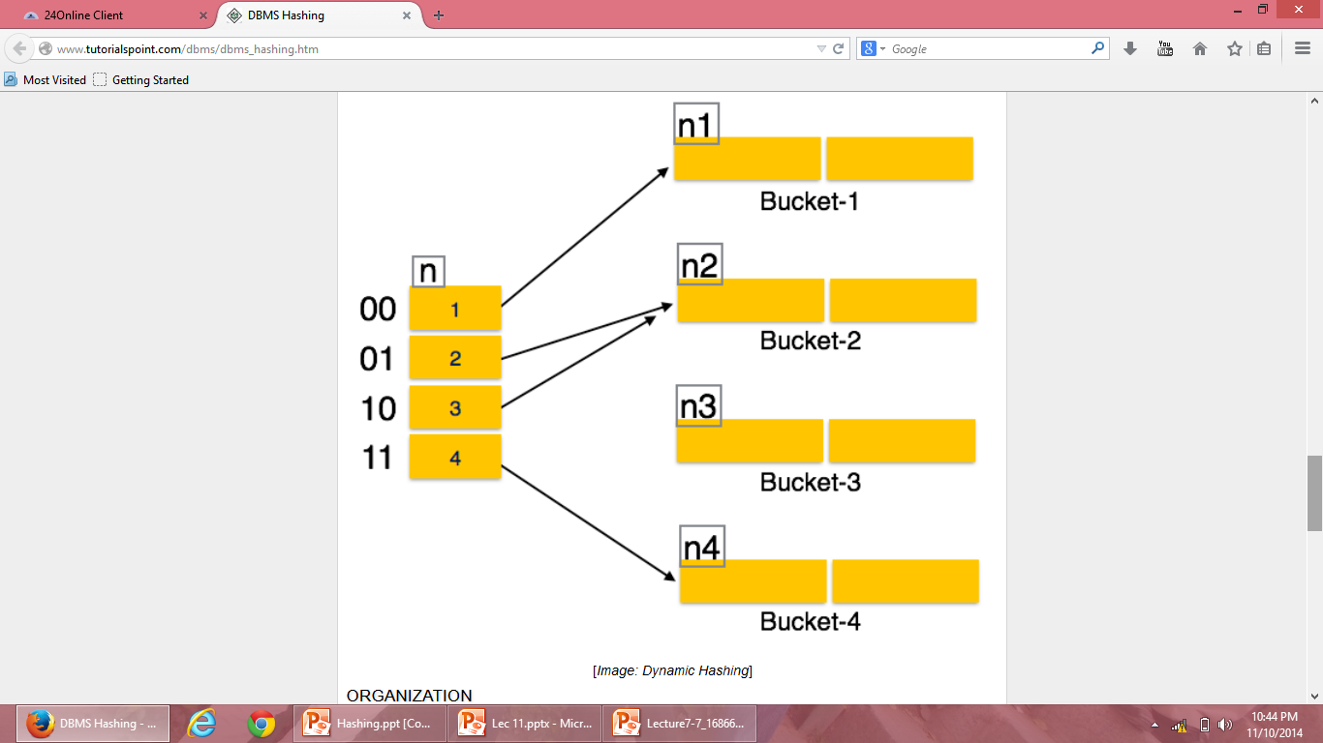
Dynamic Hashing

Slide 30
Hashing Practice Problems Problem 1
Consider a hash table of size seven, with starting index zero, and a hash function (3x + 4)mod7. Assuming the hash table is initially empty, which of the following is the contents of the table when the sequence 1, 3, 8, 10 is inserted into the table using Open hashing? Note that ‘_’ denotes an empty location in the table.
(A) 8, _, _, _, _, _, 10 (B) 1, 8, 10, _, _, _, 3 (C) 1, _, _, _, _, _,3 (D) 1, 10, 8, _, _, _, 3

Slide 31
1=> (3x+4)mod7=7mod7=0
3 => (3x+4)mod7=13mod7=6
8 => (3x+4)mod7=28mod7=0
Because address ‘0’ is not empty, store 8 at next empty data bucket ‘1’
10 => (3x+4)mod7=34mod7=6
Because address ‘6’ is not empty, store 10 at next empty data bucket ‘2’
Correct option is B

Slide 32
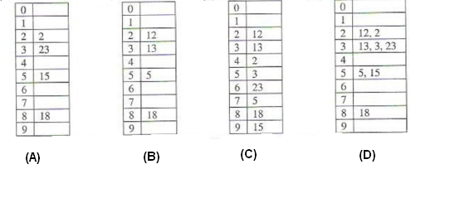
Problem 2
The keys 12, 18, 13, 2, 3, 23, 5 and 15 are inserted into an initially empty hash table of length 10 using open addressing with hash function h(k) = k mod 10 and linear probing. What is the resultant hash table?

Slide 33
H(k)=kmod10
12=> 12mod10=2
18=>18mod10=8
13=>13mod10=3
2=>2mod10=2, not empty, next available=4
3=>3mod10=3, not empty, next available=5
23=>23mod10=3, not empty, next available=6
5=>5mod10=5, not empty, next available=7
15=>15mod10=5, not empty, next available=9
Correct option is C

Slide 34
Problem 3
For question number 2, what would the correct option if method used is closed hashing?
H(k)=kmod10
12=> 12mod10=2
18=>18mod10=8
13=>13mod10=3
2=>2mod10=2
3=>3mod10=3
23=>23mod10=3
5=>5mod10=5
15=>15mod10=5
Correct option is D

Slide 35
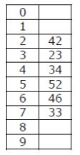
Problem 4
A hash table of length 10 uses open addressing with hash function h(k)=k mod 10, and linear probing. After inserting 6 values into an empty hash table, the table is as shown below.

Slide 36
Which one of the following choices gives a possible order in which the key values could have been inserted in the table? (A) 46, 42, 34, 52, 23, 33 (B) 34, 42, 23, 52, 33, 46 (C) 46, 34, 42, 23, 52, 33 (D) 42, 46, 33, 23, 34, 52

Slide 37
Solution: We will check whether sequence given in option A can lead to hash table given in question. Option A inserts 46, 42, 34, 52, 23, 33 as:
For key 46, h(46) is 46%10 = 6. Therefore, 46 is placed at 6th index For key 42, h(42) is 42%10 = 2. Therefore, 42 is placed at 2nd index For key 34, h(34) is 34%10 = 4. Therefore, 34 is placed at 4th index
For key 52, h(52) is 52%10 = 2. However, index 2 is occupied with 42. Therefore, 52 is placed at 3rd index in the hash table. But in given hash table, 52 is placed at 5th index. Therefore, sequence in option A can’t generate hash table given in question.
In the similar way, we can check for other options as well which leads to answer as (C).

